Slide 1

LRT Line 1 (using graph in java)
Bolanos, Jap
Laureano, Neal
Tenerife, Tristan
Verzosa, Miguel

Slide 2

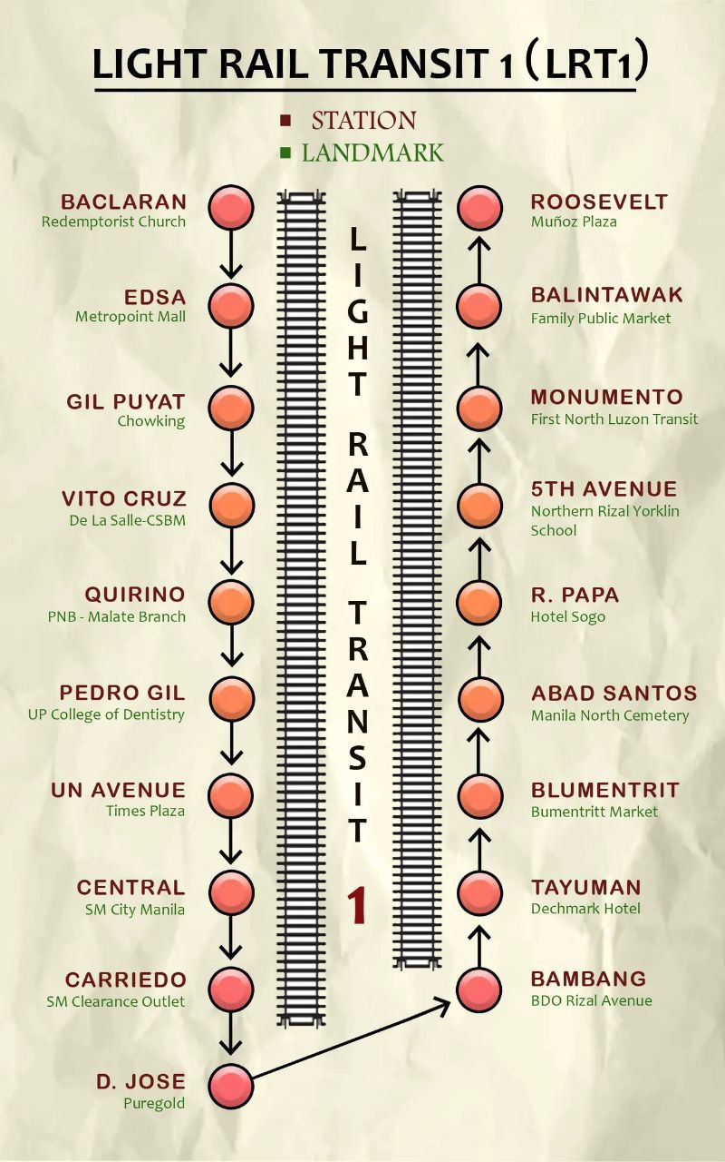
LRT LINE 1 STATIONS WITH LANDMARKS

Slide 3
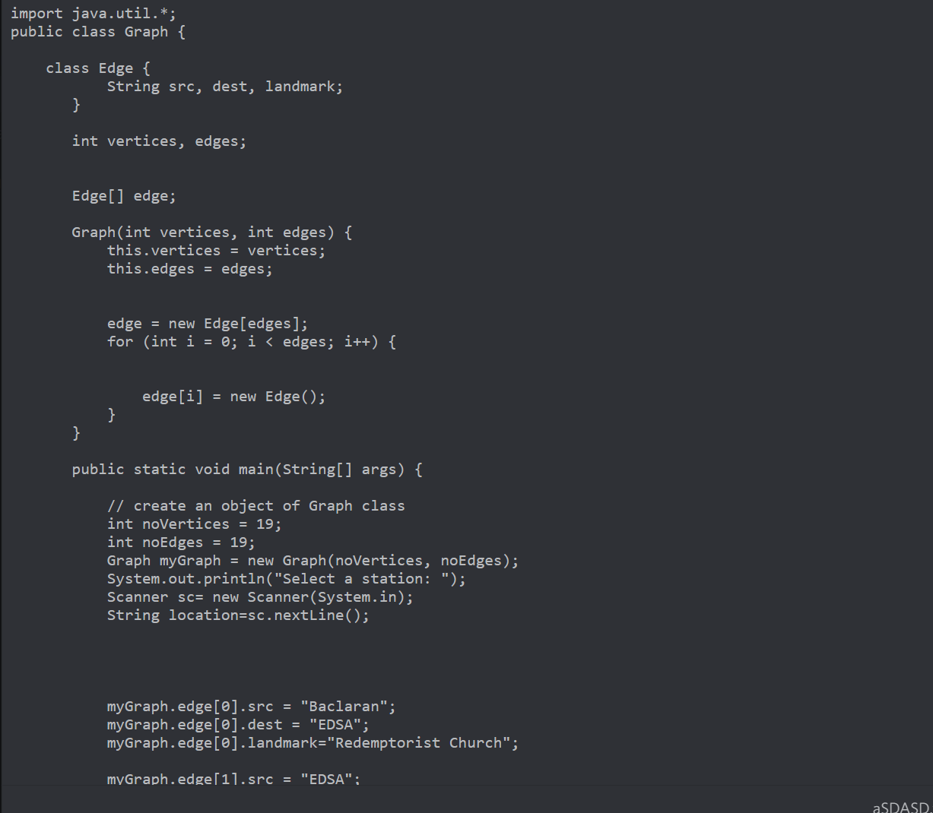

Slide 4
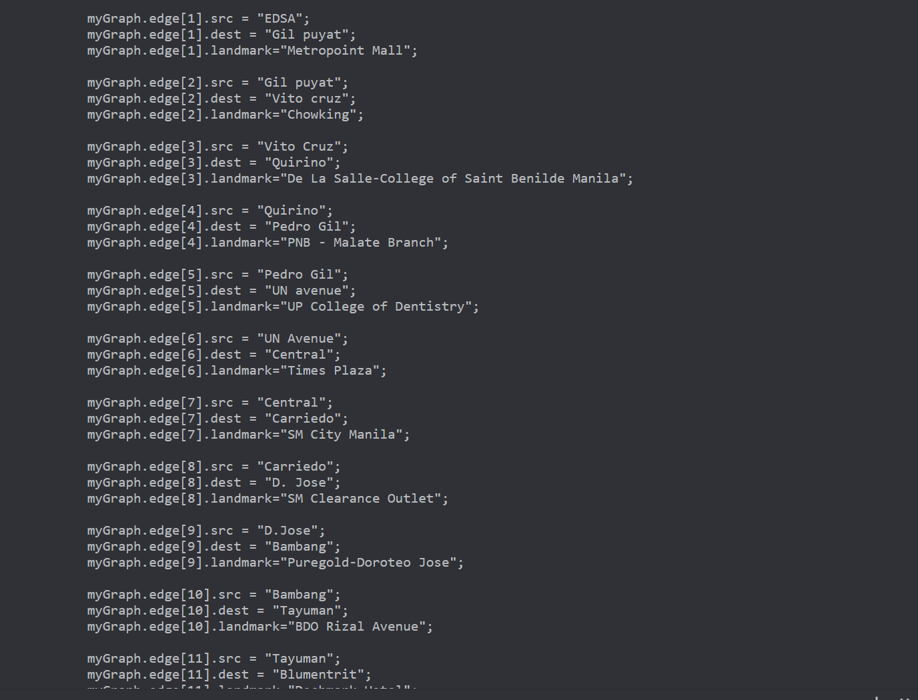

Slide 5
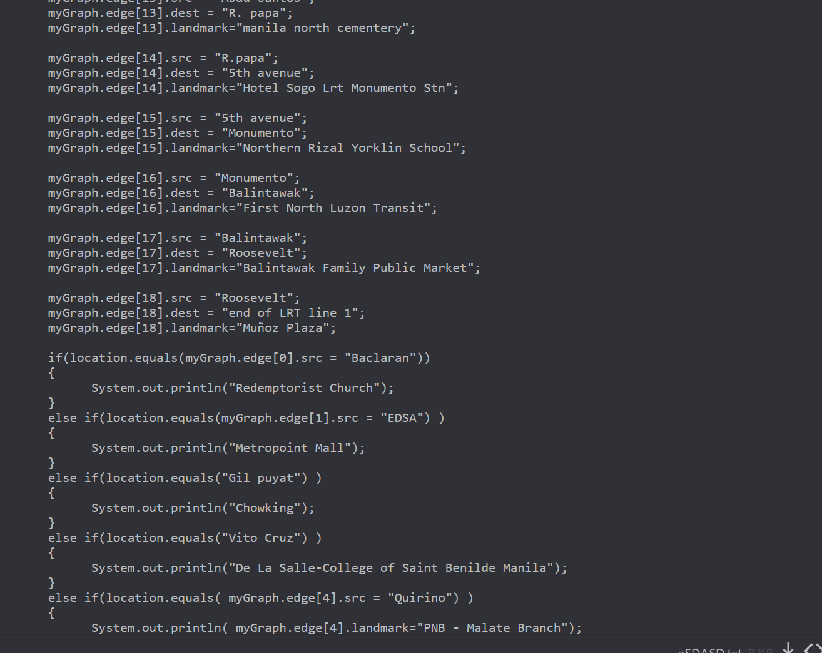

Slide 6
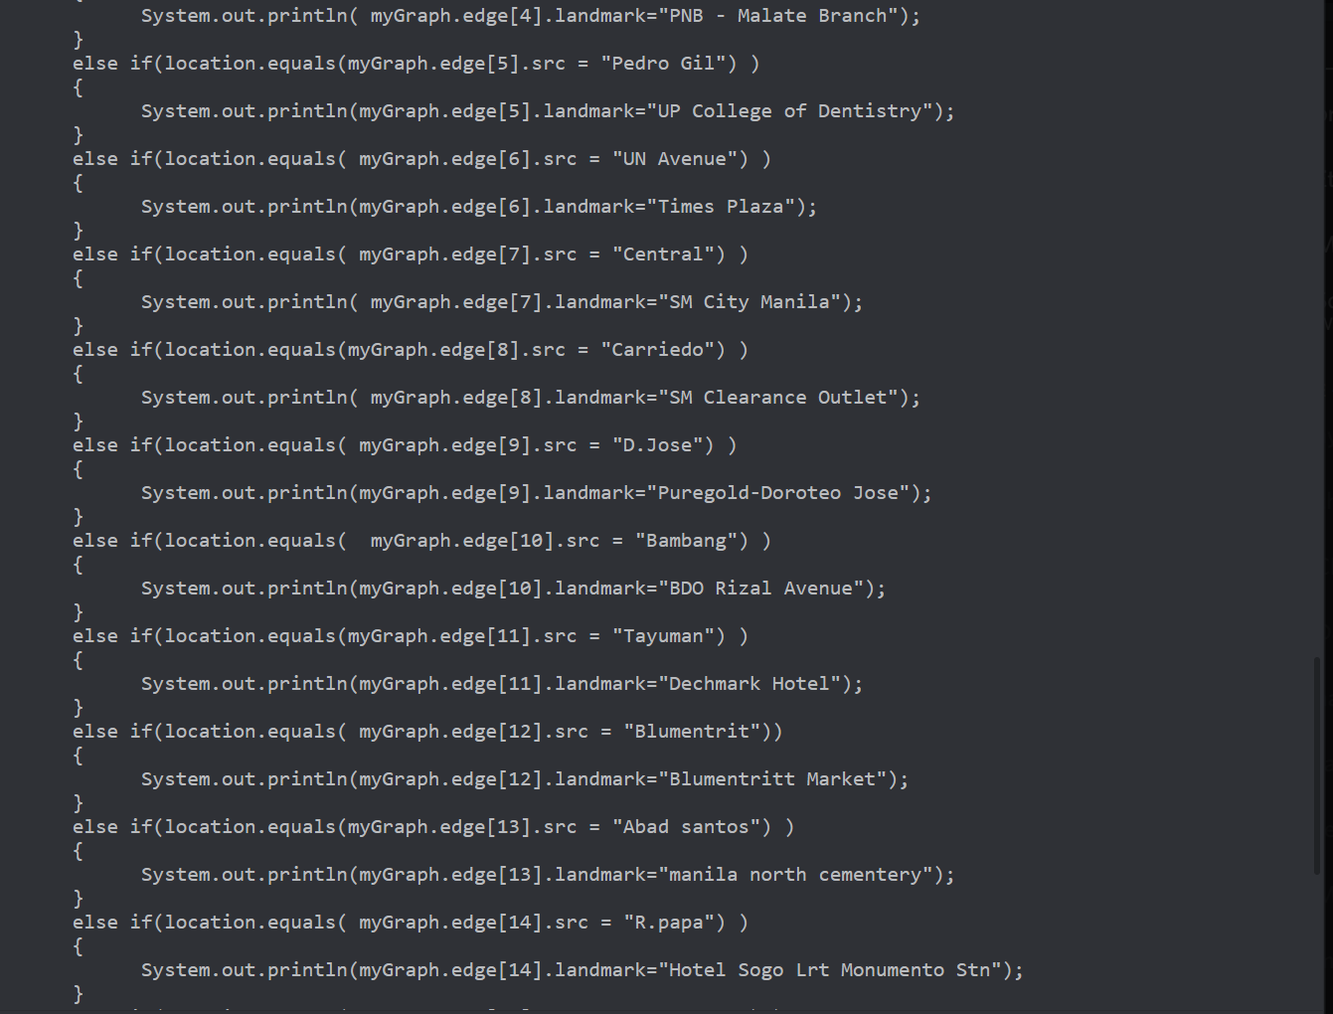

Slide 7
